Slide 1
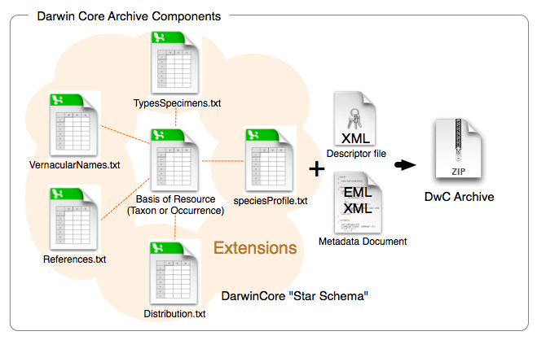

Darwin Core Archive
Darwin Core Archive (DwC-A) is the standard for publishing biodiversity data using Darwin Core terms
Star-schema
Notes:
Darwin Core Archive (DwC-A) is the standard for packaging and publishing biodiversity data using Darwin Core terms. It is the preferred format for publishing data in OBIS and GBIF. A Darwin Core Archive contains a number of text files, including data tables formatted as CSV.
The conceptual data model of the Darwin Core Archive is a star schema with a single core table, for example containing occurrence records or event records, at the center of the star. Extension tables can optionally be associated with the core table. It is not possible to link extension tables to other extension tables (to form a so-called snowflake schema). There is a one-to-many relationship between the core and extension records, so each core record can have zero or more extension records linked to it, and each extension record must be linked to exactly one core record. Definitions for the core and extension tables can be found here.
Besides data tables, a Darwin Core Archive also contains two XML files: one file which describes the archive and data file structure (meta.xml), and one file which contains the dataset’s metadata (eml.xml).

Slide 2
DwC and OBIS - Required Terms
Eight required DwC terms for an OBIS contribution:
occurrenceID
- institutionCode + collectionCode + catalogNumber
eventDate
- uses the ISO 8601 standard, yyyy-mm-ddThh:mm:ss
decimalLongitude, decimalLatitude
- spatial reference system EPSG:4326
scientificName
- originally recorded, highest precision possible
scientificNameID
- from WoRMS
occurrenceStatus
- presence/absence of taxon at location
basisOfRecord
- specimen preserved? If so where. Human or Machine Observation
Notes:
OBIS currently has eight required DwC terms:
occurrenceID, eventDate, decimalLongitude, decimalLatitude, scientificName, scientificNameID, occurrenceStatus, basisOfRecord.
occurrenceID could be constructed by combining the institutionCode, the collectionCode and the catalogNumber
basisOfRecord - specimen preserved, need information about where it is stored, collection etc
No specimen preserved - HumanObservation vs MachineObservation
occurrenceID could be constructed by combining the institutionCode, the collectionCode and the catalogNumber
basisOfRecord - specimen preserved, need information about where it is stored, collection etc
No specimen preserved - HumanObservation vs MachineObservation

Slide 3
OBIS data formats
Occurrence Core
Occurrence Core
Event Core
Core
ExtendedMeasurementOrFact
Occurrence
Extensions
ExtendedMeasurementOrFact
Notes:
Data collected as part of marine biological research often include measurements of habitat features (such as physical and chemical parameters of the environment), biotic and biometric measurements (such as body size, abundance, biomass), as wel as details regarding the nature of the sampling or observation methods, equipment, and sampling effort.
In the past, OBIS relied solely on the Occurrence Core, and additional measurements were added in a structured format (e.g. JSON) in the Darwin Core term dynamicProperties inside the occurrence records. This approach had significant downsides: the format is difficult to construct and deconstruct, there is no standardization of terms, and attributes which are shared by multiple records (think sampling methodology) have to be repeated many times. The formatting problem can be addressed by moving measurements to a MeasurementOrFacts extension table, but that doesn't solve the redundancy and standardization problems.
With the release and adoption of a new core type Event Core it became possible to associate measurements with nested events (such as cruises, stations, and samples), but the restrictive star schema of Darwin Core archive prohibited associating measurements with the event records in the Event core as well as with the occurrence records in the Occurrence extension. For this reason an extended version of the existing MeasurementOrFact extension was created.

Slide 4
Occurrence Core
When to use Occurrence Core?
No information on how the data was sampled or samples were processed.
No abiotic measurements are taken or provided
Biological measurements are made on individual specimens (each specimen is a single occurrence record)
This is often the case for museum collections, citations of occurrences from literature, individual sightings.
Minimum of 8 (required) DwC terms
scientificName | scientificNameID | occurrenceID | eventDate | decimalLatitude | decimalLongitude | occurrenceStatus | basisOfRecord
Arca zebra | urn:lsid:marinespecies.org:taxname:420713 | MCNUSB_001 | 1999-01-01 | 10.7413 | -63.8791 | Present | PreservedSpecimen
Perna viridis | urn:lsid:marinespecies.org:taxname:367822 | MCNUSB_002 | 1999-01-01 | 10.7413 | -63.8791 | Present | PreservedSpecimen
Phyllonotus pomum | urn:lsid:marinespecies.org:taxname:419944 | MCNUSB_003 | 1999-01-01 | 10.7413 | -63.8791 | Present | PreservedSpecimen
Strombus pugilis | urn:lsid:marinespecies.org:taxname:419695 | MCNUSB_047 | 1999-01-01 | 10.8737 | -63.8805 | Present | PreservedSpecimen
Trachycardium | urn:lsid:marinespecies.org:taxname:203976 | MCNUSB_075 | 1999-01-01 | 10.8477 | -68.2424 | Present | PreservedSpecimen
Chione cancellata | urn:lsid:marinespecies.org:taxname:397040 | MCNUSB_006 | 1999-01-01 | 10.6886 | -63.8514 | Present | PreservedSpecimen
Atrina seminuda | urn:lsid:marinespecies.org:taxname:420740 | MCNUSB_007 | 1999-01-01 | 10.6886 | -63.8514 | Present | PreservedSpecimen
Lyropecten | urn:lsid:marinespecies.org:taxname:203879 | MCNUSB_004 | 1999-01-01 | 10.7413 | -63.8791 | Present | PreservedSpecimen

Slide 5
Occurrence Core + ExtendedMeasurementOrFact Extension
Occurrences and measurements made on individual specimens, e.g. body size, counts, wet weight, life stage, etc.
scientificName | scientificNameID | occurrenceID | eventDate | decimalLatitude | decimalLongitude | occurrenceStatus | basisOfRecord
Arca zebra | urn:lsid:marinespecies.org:taxname:420713 | MCNUSB_001 | 1999-01-01 | 10.7413 | -63.8791 | Present | PreservedSpecimen
Perna viridis | urn:lsid:marinespecies.org:taxname:367822 | MCNUSB_002 | 1999-01-01 | 10.7413 | -63.8791 | Present | PreservedSpecimen
Phyllonotus pomum | urn:lsid:marinespecies.org:taxname:419944 | MCNUSB_003 | 1999-01-01 | 10.7413 | -63.8791 | Present | PreservedSpecimen
Strombus pugilis | urn:lsid:marinespecies.org:taxname:419695 | MCNUSB_047 | 1999-01-01 | 10.8737 | -63.8805 | Present | PreservedSpecimen
Trachycardium | urn:lsid:marinespecies.org:taxname:203976 | MCNUSB_075 | 1999-01-01 | 10.8477 | -68.2424 | Present | PreservedSpecimen
Chione cancellata | urn:lsid:marinespecies.org:taxname:397040 | MCNUSB_006 | 1999-01-01 | 10.6886 | -63.8514 | Present | PreservedSpecimen
Atrina seminuda | urn:lsid:marinespecies.org:taxname:420740 | MCNUSB_007 | 1999-01-01 | 10.6886 | -63.8514 | Present | PreservedSpecimen
Lyropecten | urn:lsid:marinespecies.org:taxname:203879 | MCNUSB_004 | 1999-01-01 | 10.7413 | -63.8791 | Present | PreservedSpecimen
occurrenceID | measurementType | measurementTypeID | measurementValue | measurementValueID | measurementUnit | measurementUnitID
MCNUSB_001 | Length | http://vocab.nerc.ac.uk/collection/P01/current/OBSINDLX | 4 |  | cm | http://vocab.nerc.ac.uk/collection/P06/current/ULCM
MCNUSB_001 | Wetweightbiomass | http://vocab.nerc.ac.uk/collection/P01/current/OWETBM01 | 10 |  | gr | http://vocab.nerc.ac.uk/collection/P06/current/UGRM/
MCNUSB_002 | Length | http://vocab.nerc.ac.uk/collection/P01/current/OBSINDLX | 3 |  | cm | http://vocab.nerc.ac.uk/collection/P06/current/ULCM
MCNUSB_002 | Wetweightbiomass | http://vocab.nerc.ac.uk/collection/P01/current/OWETBM01 | 15 |  | gr | http://vocab.nerc.ac.uk/collection/P06/current/UGRM/
MCNUSB_003 | Length | http://vocab.nerc.ac.uk/collection/P01/current/OBSINDLX | 8 |  | cm | http://vocab.nerc.ac.uk/collection/P06/current/ULCM
MCNUSB_003 | Wetweightbiomass | http://vocab.nerc.ac.uk/collection/P01/current/OWETBM01 | 80 |  | gr | http://vocab.nerc.ac.uk/collection/P06/current/UGRM/
Notes:
As part of the IODE pilot project Expanding OBIS with environmental data OBIS-ENV-DATA, OBIS introduced a custom ExtendedMeasurementOrFact or eMoF extension, which extends the existing MeasurementOrFact extension with 4 new terms:
occurrenceID
measurementTypeID
measurementValueID
measurementUnitID
The occurrenceID term is used to circumvent the limitations of the star schema, and link measurement records in the ExtendedMeasurementOrFact extension to occurrence records in the Occurrence extension. Note that in order to comply with the Darwin Core Archive standard, these records still need to link to an event record in the Event core table as well.

Slide 6
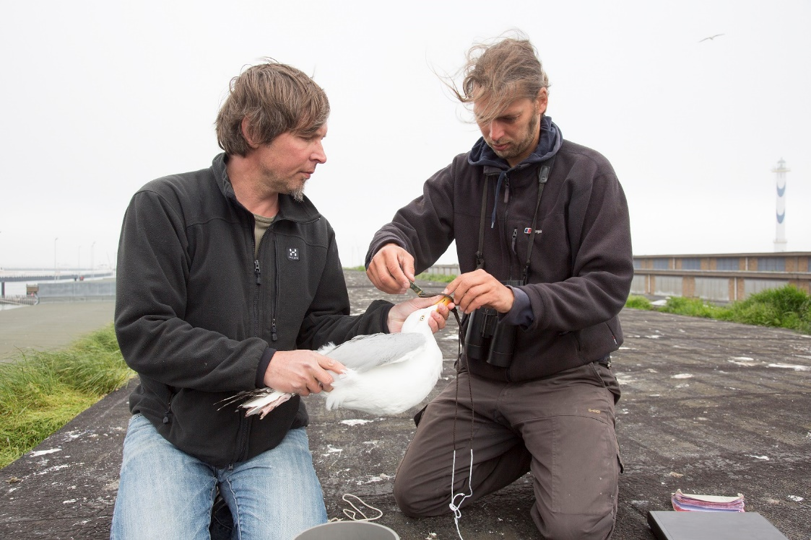
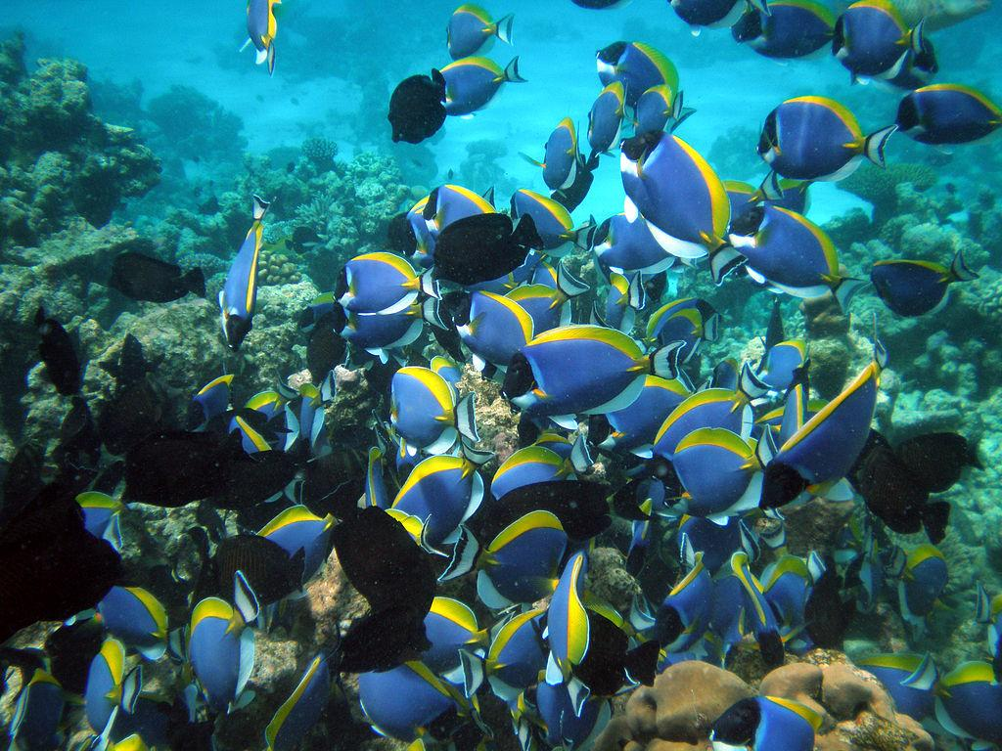
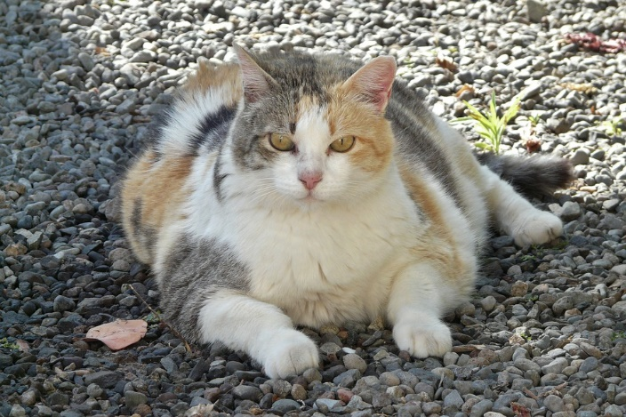
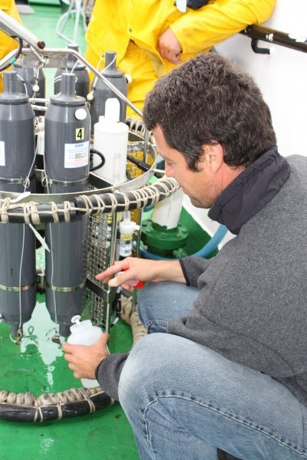
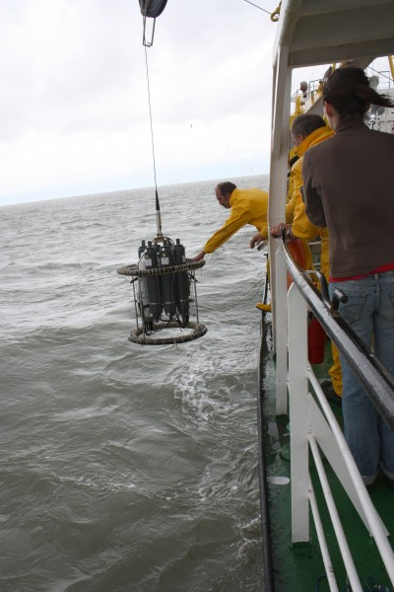
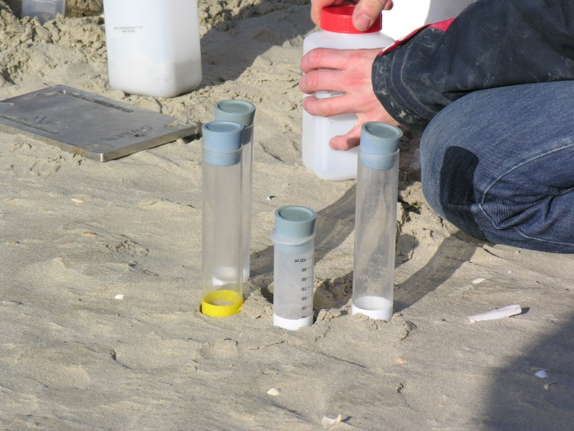
Biotic measurements
Abundances
Biomass
Sediment sampling
CTD measurements
Nutrient concentrations
Notes:
Thanks to this term we can now store a variety of measurements and facts linked to either events or occurrences:
organism quantifications (e.g. counts, abundance, biomass, % live cover, etc.)
species biometrics (e.g. body length, weight, etc.)
facts documenting a specimen (e.g. living/dead, behaviour, invasiveness, etc.)
abiotic measurements (e.g. temperature, salinity, oxygen, sediment grain size, habitat features)
facts documenting the sampling activity (e.g. sampling device, sampled area, sampled volume, sieve mesh size).

Slide 7
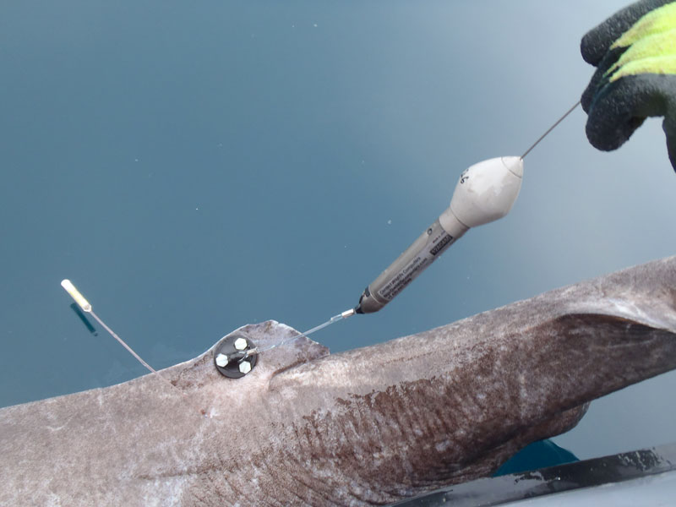
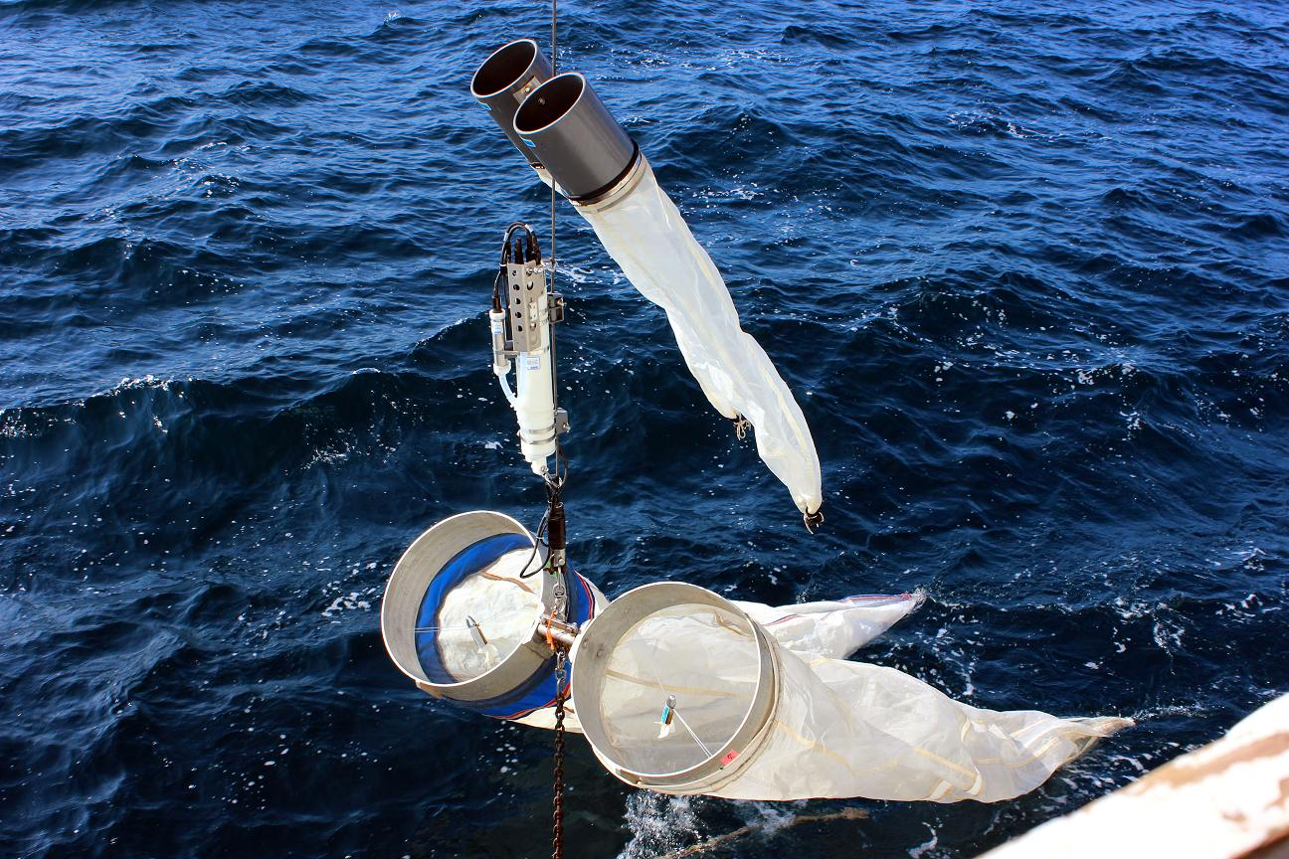
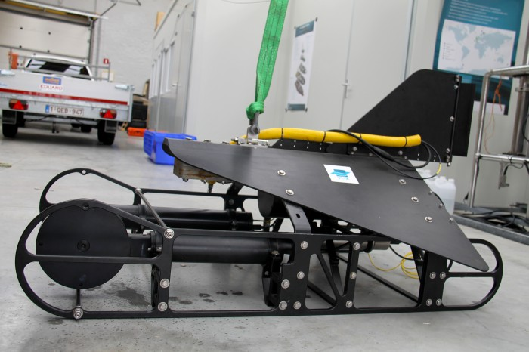
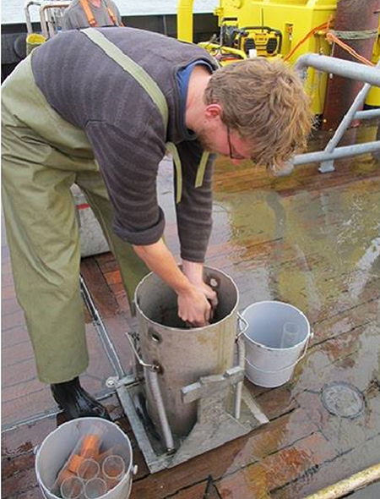
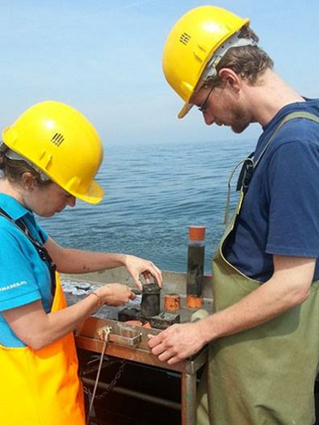
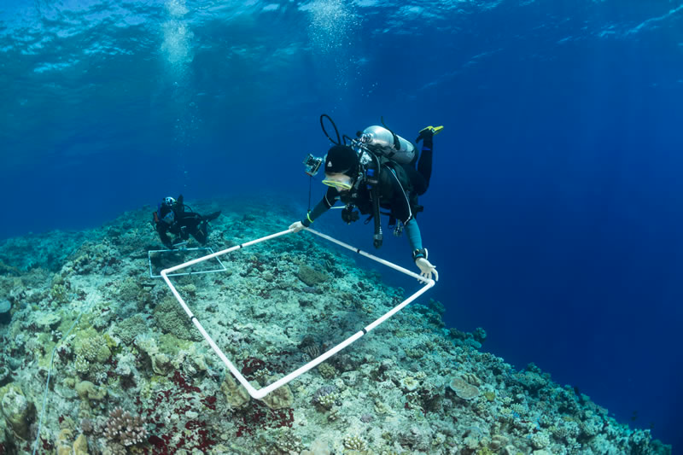
OTN tags
Planktonnet + CTD
VPR
livingoceansfoundation
Subsamples and slices
Habitat coverage - bleaching

Slide 8
Event Core + Occurrence Extension
eventID | parentEventID | type | eventDate | decimalLatitude | decimalLongitude | coordinateUncertaintyInMeters | minimumDepthInMeters | maximumDepthInMeters | footprintWKT
plankton_nov2009 |  | cruise | 2009-11-25
plankton_nov2009:S1 | plankton_nov2009 | station | 2009-11-25 | 10.854039 | -63.697436 |  | 1 | 2
plankton_nov2009:S1:dragging | plankton_nov2009:S1 | Plankton transect | 2009-11-25 | 10.853500 | -63.698400 | 33 | 1 | 2 | LINESTRING (-63.69870 10.85351, -63.69809 10.85352)
plankton_nov2009:S1:dragging:T1 | plankton_nov2009:S1:dragging | CTD | 2009-11-25 | 10.853450 | -63.698586 |  | 1 | 2
plankton_nov2009:S1:dragging:T2 | plankton_nov2009:S1:dragging | CTD | 2009-11-25 | 10.853469 | -63.698422 |  | 1 | 2
plankton_nov2009:S1:dragging:T3 | plankton_nov2009:S1:dragging | CTD | 2009-11-25 | 10.853492 | -63.698511 |  | 1 | 2
eventID | occurrenceID | scientificName | scientificNameID | scientificNameAuthorship | basisOfRecord | occurrenceStatus
plankton_nov2009:S1:dragging | MCNUSB_plank0001 | Rhizosolenia | urn:lsid:marinespecies.org:taxname:149069 | T. Brightwell, 1858 | HumanObservation | Present
plankton_nov2009:S1:dragging | MCNUSB_plank0002 | Noctiluca scintillans | urn:lsid:marinespecies.org:taxname:109921 | (Macartney) Kofoid & Swezy, 1921 | HumanObservation | Present
plankton_nov2009:S1:dragging | MCNUSB_plank0003 | Thalassiothrix frauenfeldii | urn:lsid:marinespecies.org:taxname:176365 | (Grunow) Grunow, 1880 | HumanObservation | Present
plankton_nov2009:S1:dragging | MCNUSB_plank0004 | Ceratium fusus | urn:lsid:marinespecies.org:taxname:109951 | (Ehrenberg) Dujardin, 1841 | HumanObservation | Present
plankton_nov2009:S1:dragging | MCNUSB_plank0005 | Chaetoceros coarctatum | urn:lsid:marinespecies.org:taxname:178180 | Lauder, 1864 | HumanObservation | Present
plankton_nov2009:S2:dragging | MCNUSB_plank0006 | Chaetoceros | urn:lsid:marinespecies.org:taxname:148985 | C.G. Ehrenberg, 1844 | HumanObservation | Present
plankton_nov2009:S2:dragging | MCNUSB_plank0007 | Guinardia | urn:lsid:marinespecies.org:taxname:149111 | H. Peragallo, 1892 | HumanObservation | Present
Measurements and Sampling facts?

Slide 9
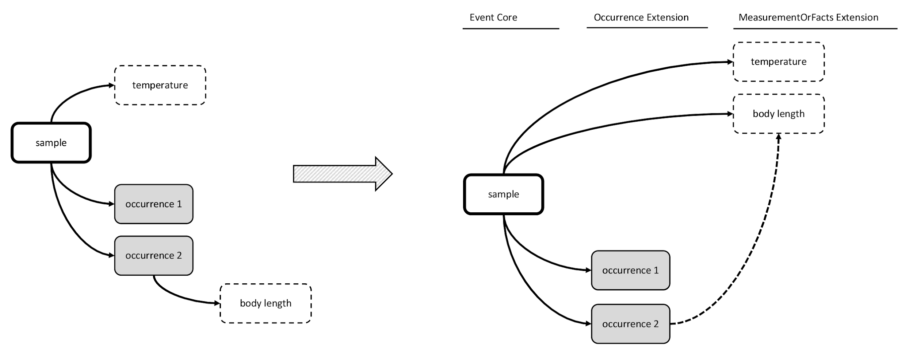
MeasurmentOrFact Extension
X
Not compatible with DwC-A star schema

Slide 10
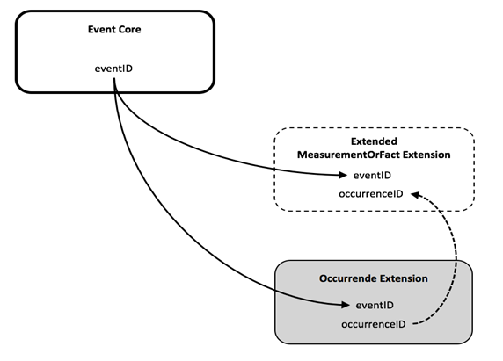
OBIS-ENV-DATA proposed the ExtendedMeasurementOrFact Extension
Three files:
Sample or Observation (time, location, depth, event hierarchy)
Sampling protocol
(equipment, methods)
Sampling effort
(length, duration, volume,…)
Environment/habitat variables
(physical, chemical, sediment,…)
Biological variables
(Abundance, biomass, length, behavior, lifestage, traits …)
Occurrence details
(taxonomy, identification, organismID. …)
Note: All Measurement Types, Values and Units are standardized against a controlled vocabulary (BODC NERC Vocab)

Slide 11
Event Core
When to use Event Core?
When the dataset contains abiotic measurements, or other biological measurements which are related to an entire sample (not a single specimen)
When specific details are known about how a biological sample was taken and processed.
Event Core should be used in combination with the Occurrence Extension and the ExtendedMeasurementOrFact Extension.

Slide 12
ExtendedMeasurementOrFact Extension (eMoF)
The eMoF extension is used to store:
Organism quantifications (e.g. counts, abundance, biomass, % live cover, etc.)
Species biometrics (e.g. body length, weight, etc.)
Facts documenting a specimen (e.g. sex, lifestage, living/dead, behavior, invasiveness, etc.)
Abiotic measurements (e.g. temperature, salinity, oxygen, sediment grain size, habitat features)
Facts documenting the sampling activity (e.g. sampling device, sampled area, sampled volume, sieve mesh size).

Slide 13
DwC terms
Event
Occurrences
MeasurementOrFacts
eventID
parentEventID
eventDate
habitat
minimumDepthInMeters
maximumDepthInMeters
decimalLatitude
decimalLongitude
coordinateUncertaintyInMeters
footprintWKT
modified
eventID
occurrenceID
scientificName
scientificNameAuthorship
scientificNameID
kingdom
taxonRank
identificationQualifier
occurrenceStatus
basisOfRecord
modified
measurementID
eventID
occurrenceID
measurementType
measurementTypeID
measurementValue
measurementValueID
measurementUnit
measurementUnitID
measurementAccuracy
measurementRemarks
NERC vocab
NERC vocab
NERC vocab

Slide 14
Event Core – OBIS-ENV-Data schema
Event 1
eMoF A1
vocab
Event 1.1
eMoF A2
vocab
Event 1.1.1
eMoF B1
vocab
Occ 1
vocab
eMoF B3
Occ 3
WoRMS
Occ 2
WoRMS
eMoF B2
vocab
WoRMS

Slide 15
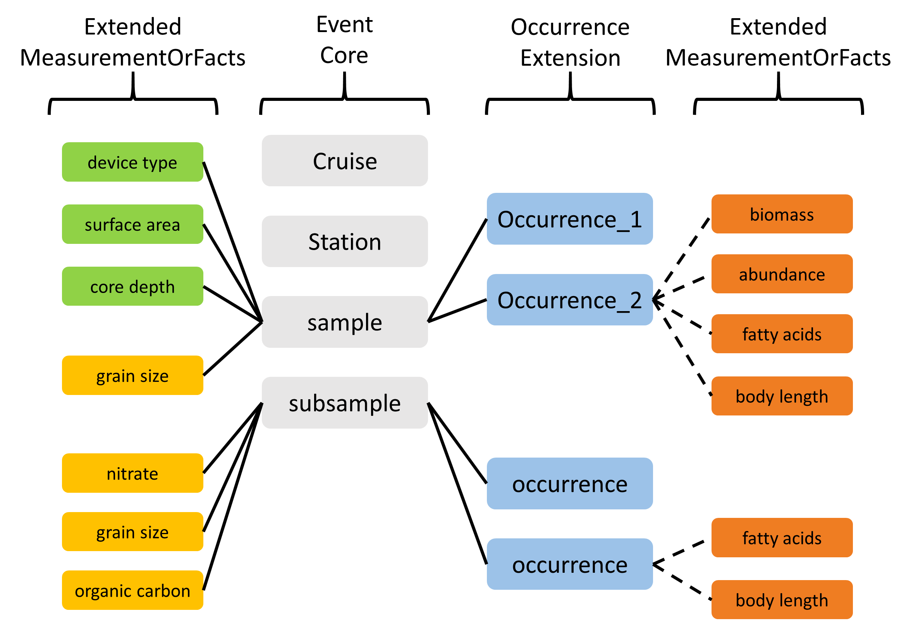

Slide 16
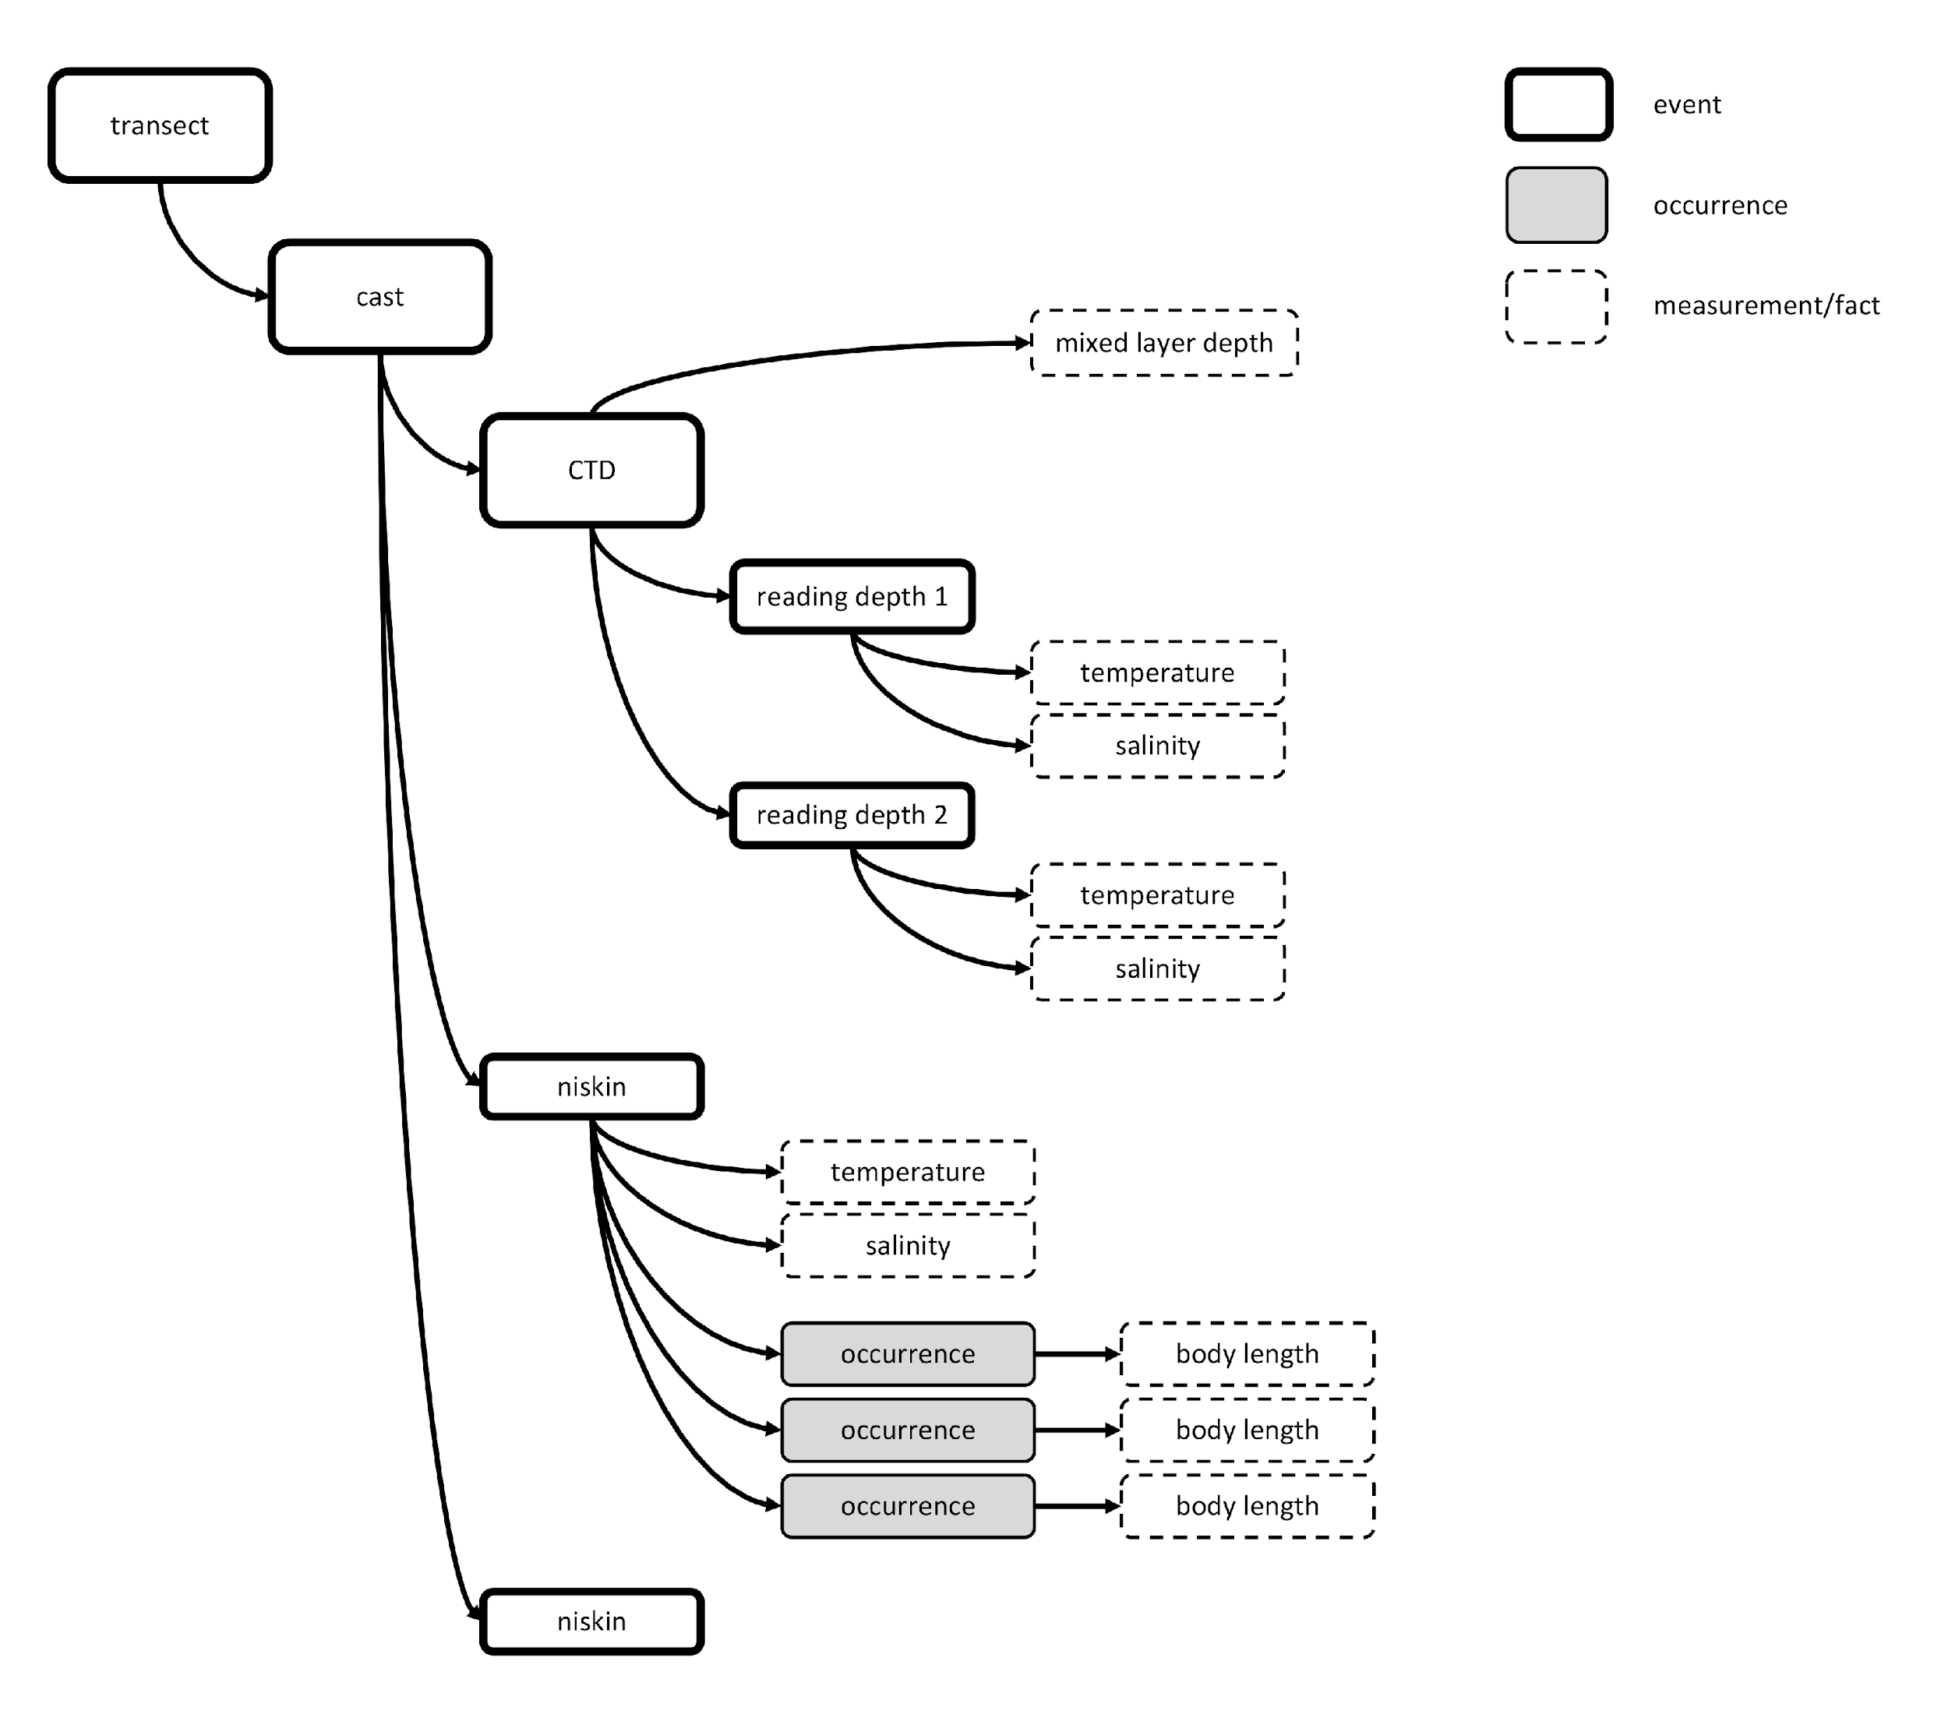
CTD measurements

Slide 17
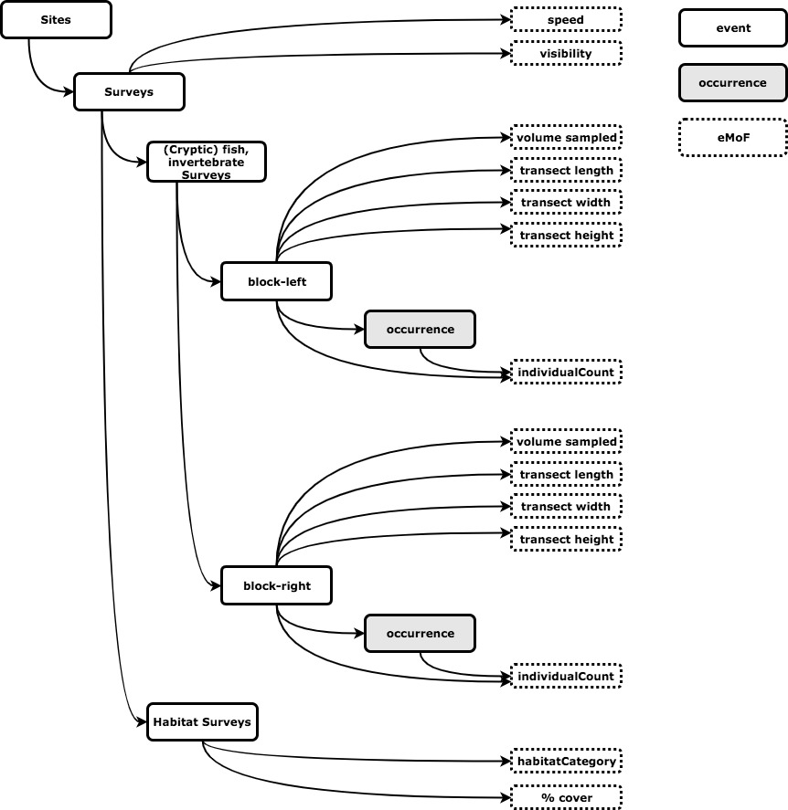

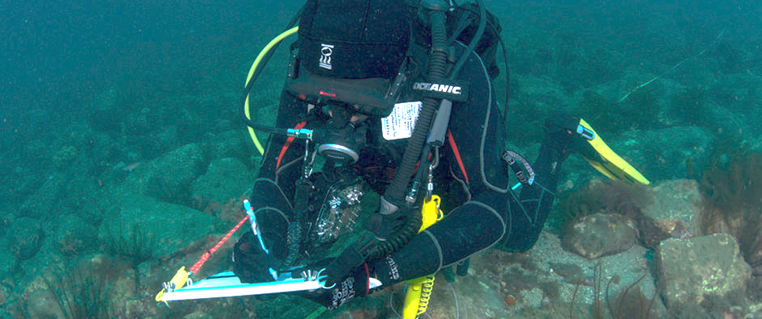
Example subset

Slide 18
Measurements or facts Vocabulary
The MoF terms: measurementType, measurementValue and measurementUnit are completely unconstrained and can be populated with free text annotation.
OBIS uses the controlled vocabulary developed and maintained by the British Oceanographic Data Center (BODC), and made available through the NERC Vocabulary server: https://www.bodc.ac.uk/resources/vocabularies/vocabulary_search/.
measurementTypeID
BODC Parameter Usage Vocabulary (P01): http://vocab.nerc.ac.uk/collection/P01/current
OBIS sampling instruments and methods attributes (Q01): http://vocab.nerc.ac.uk/collection/Q01/current/
measurementValueID
Sampling instruments and sensors (SeaVoX Device Catalogue): http://vocab.nerc.ac.uk/collection/L22/current
Sampling instrument categories (SeaDataNet device categories): http://vocab.nerc.ac.uk/collection/L05/current
Vessels (ICES Platform Codes): http://vocab.nerc.ac.uk/collection/C17/current
Lifestage: http://vocab.nerc.ac.uk/collection/S11/current/
DOIs of papers or manuals on the sampling protocol used, published e.g. on IOC’s Ocean Best Practices repository, for example: http://hdl.handle.net/11329/304
MeasurementUnitID
Units: http://vocab.nerc.ac.uk/collection/P06/current
Notes:
The MeasurementOrFact terms measurementType, measurementValue and measurementUnit are completely unconstrained and can be populated with free text annotation.
While free text offers the advantage of capturing complex and as yet unclassified information, the inevitable semantic heterogeneity (e.g. of spelling or wording) becomes a major challenge for effective data integration and analysis.
Hence, OBIS added 3 new terms: measurementTypeID, measurementValueID and measurementUnitID to standardise the measurement types, values and units. Note that measurementValueID is not used for standardizing numeric measurements.
The three new terms should be populated using controlled vocabularies referenced using Unique Resource Identifiers (URIs).
OBIS recommends to use the internationally recognized NERC Vocabulary Server, developed by the British Oceanographic Data Centre (BODC), which can be searched through https://www.bodc.ac.uk/resources/vocabularies/vocabulary_search/.

Slide 19
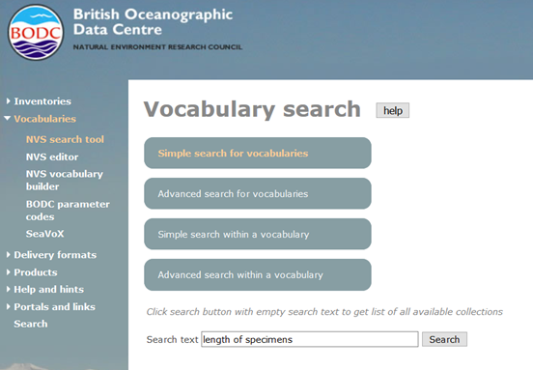
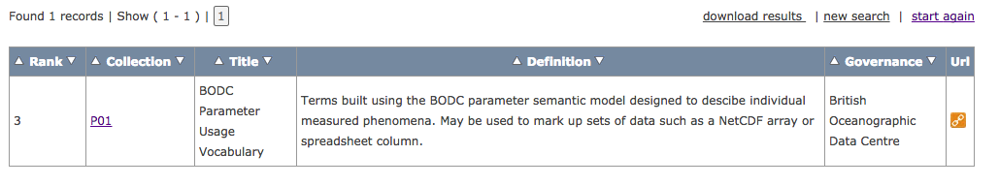
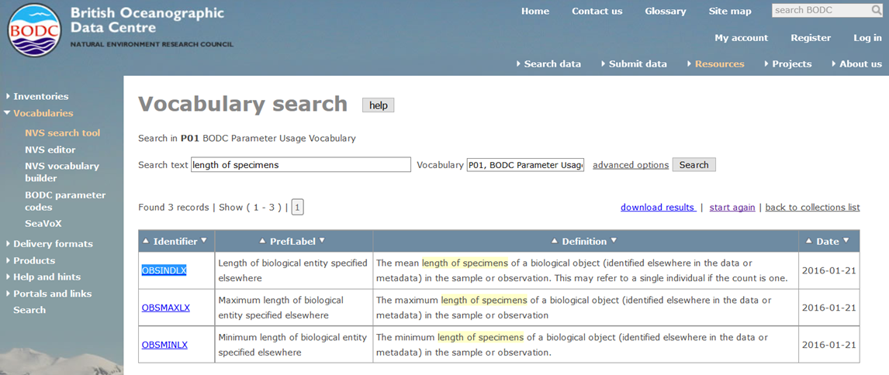
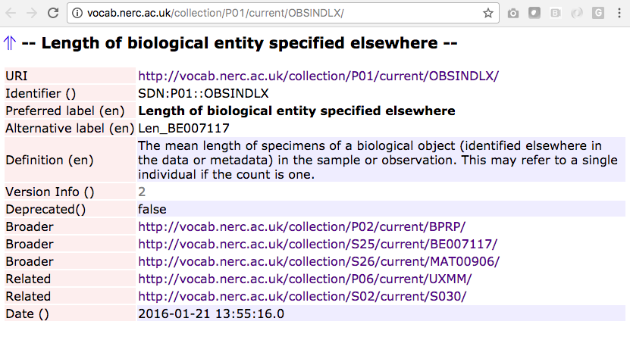
https://www.bodc.ac.uk/resources/vocabularies/vocabulary_search/.

Slide 20
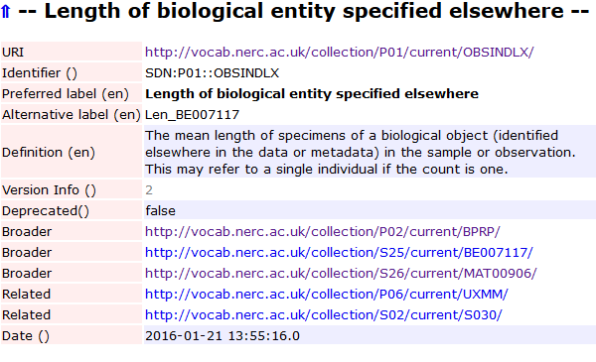
Data Standardisation
MeasurementType
MeasurementValue
MeasurementUnit
+ MeasurementTypeID
+ MeasurementValueID
+ MeasurementUnitID
Extended MoF Extension
Controlled vocabulary
Persistent identifiers (URIs)
MeasurementType MeasurementTypeID
Body length http://vocab.nerc.ac.uk/collection/P01/current/OBSINDLX
Length http://vocab.nerc.ac.uk/collection/P01/current/OBSINDLX
Length (mm) http://vocab.nerc.ac.uk/collection/P01/current/OBSINDLX
length_in_m http://vocab.nerc.ac.uk/collection/P01/current/OBSINDLX
Length of specimen http://vocab.nerc.ac.uk/collection/P01/current/OBSINDLX
…
Notes:
So for my example body length, all 5 parameters would get the same URI as measurementTypeID. Ideally, this URI resolves to a webservice through which OBIS can access the term in the vocabulary. And OBIS can get than the preferred label for this parameter or the definition.

Slide 21
Quiz time!
Data Formats Quiz.ipynb

